Slide 1
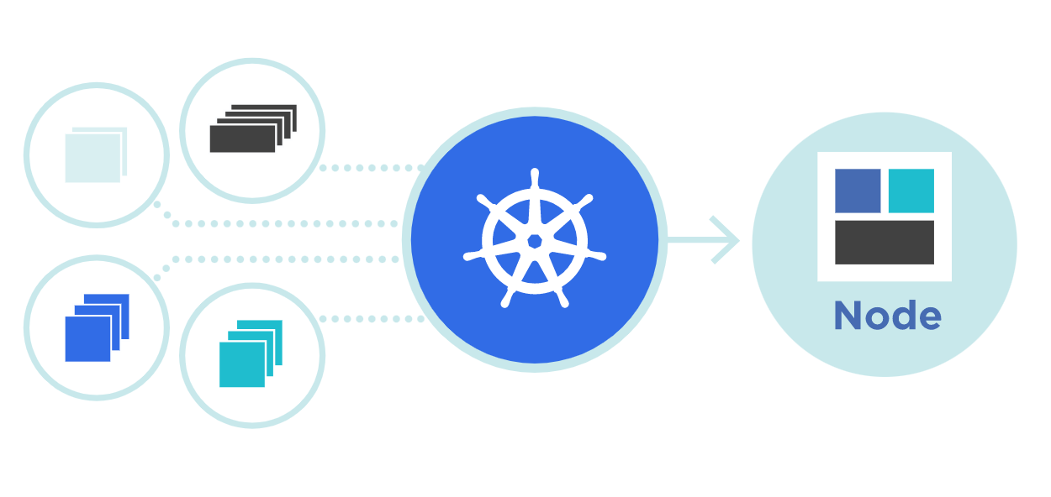



ReplicaSet
rs
Theory + LAB + Documents ➔ All free
WATCH NOW
Notes:
Hello everyone. My name is Anish Rana and you are watching Kubernetes web series.
Today, we're going to cover one interesting topic, i.e. “What is ReplicaSet?"

Slide 2
Agenda of this video.
What is ReplicaSet?
Understand the yaml file fields.
How to create Yaml file for Replicaset ?
How to create ReplicaSet from Yaml file?
How to check the ReplicaSet?
How to delete the ReplicaSet?
When to use a ReplicaSet?
LAB

Slide 3
01 NOW WE WILL TALK ABOUT
What is ReplicaSet

Slide 4
What is ReplicaSet?
rs
A ReplicaSet's purpose is to maintain a stable set of replica Pods running at any given time. As such, it is often used to guarantee the availability of a specified number of identical Pods.

Slide 5
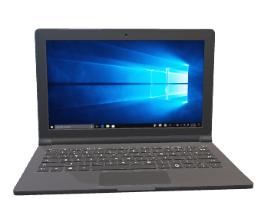
Worker node 1 / VM
Master node 1 / VM
Schedular
POD 1
C: webapp1
Kubelet
API Server
Etcd Database
Kube-Proxy
POD 2
C: database1
Controller
Kubernetes
Kubernetes
Docker Engine
Docker Engine
CentOS 9
CentOS 9

Slide 6
02 NOW WE WILL TALK ABOUT
Understand the yaml file fields

Slide 7
kubectl apply -f https://kubernetes.io/examples/controllers/frontend.yaml
apiVersion: apps/v1
kind: ReplicaSet
metadata:
name: frontend
labels:
tier: frontend
spec:

Slide 8
apiVersion: apps/v1
kind: ReplicaSet
metadata:
name: frontend
labels:
tier: frontend
spec:
replicas: 3
selector:
matchLabels:
tier: frontend
template:
metadata:
labels:
tier: frontend
spec:
containers:
- name: php-redis
image: gcr.io/google_samples/gb-frontend:v3
contain no more than 253 characters
contain only lowercase alphanumeric characters, '-' or '.'
start with an alphanumeric character
end with an alphanumeric character

Slide 9
apiVersion: apps/v1
kind: ReplicaSet
metadata:
name: frontend
labels:
tier: frontend
spec:
replicas: 3
selector:
matchLabels:
tier: frontend
template:
metadata:
labels:
tier: frontend
spec:
containers:
- name: php-redis
image: gcr.io/google_samples/gb-frontend:v3
ReplicaSet will select the pods with this label
ReplicaSet will create the pods with this label

Slide 10
apiVersion: apps/v1
kind: ReplicaSet
metadata:
name: frontend
labels:
tier: frontend
spec:
replicas: 3
selector:
matchLabels:
tier: frontend
template:
metadata:
labels:
tier: frontend
spec:
containers:
- name: php-redis
image: gcr.io/google_samples/gb-frontend:v3
Both values must be equal then only these pods will be selected by RiplicaSet

Slide 11
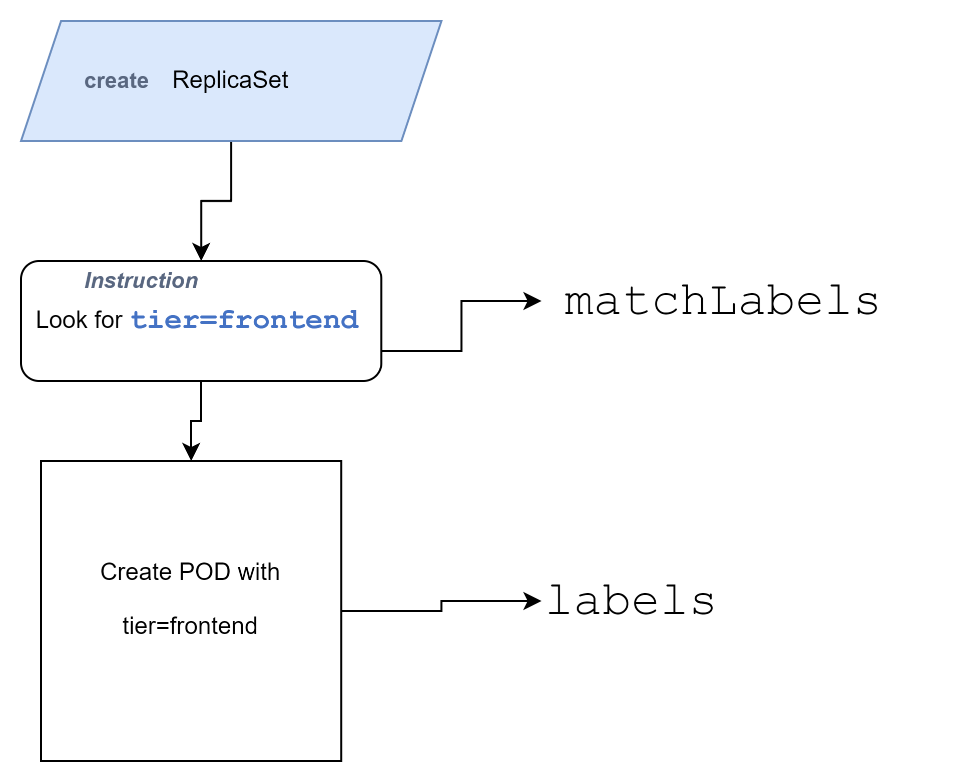

Slide 12
03 NOW WE WILL TALK ABOUT
How to create Yaml file for Replicaset ?

Slide 13
apiVersion: apps/v1
kind: ReplicaSet
metadata:
name: frontend
labels:
tier: frontend
spec:
replicas: 3
selector:
matchLabels:
tier: frontend
template:
metadata:

Slide 14
apiVersion: apps/v1
kind: ReplicaSet
metadata:
name: frontend
labels:
tier: frontend
spec:
replicas: 3
selector:
matchLabels:
tier: frontend
template:
metadata:

Slide 15
apiVersion: apps/v1
kind: ReplicaSet
metadata:
name: frontend
labels:
tier: frontend
spec:
replicas: 3
selector:
matchLabels:
tier: frontend
template:
metadata:
apiVersion: v1
kind: Pod
metadata:
name: nginx
labels:
tier: frontend
spec:
containers:
- name: php-redis
image: gcr.io/google_samples/gb-frontend:v3

Slide 16
apiVersion: apps/v1
kind: ReplicaSet
metadata:
name: frontend
labels:
tier: frontend
spec:
replicas: 3
selector:
matchLabels:
tier: frontend
template:
metadata:
labels:
tier: frontend
spec:
containers:
- name: php-redis
image: gcr.io/google_samples/gb-frontend:v3
apiVersion: v1
kind: Pod
metadata:
name: nginx

Slide 17
apiVersion: apps/v1
kind: ReplicaSet
metadata:
name: frontend
labels:
tier: frontend
spec:
replicas: 3
selector:
matchLabels:
tier: frontend
template:
metadata:
labels:
tier: frontend
spec:
containers:
- name: php-redis
image: gcr.io/google_samples/gb-frontend:v3
ReplicaSet
POD
Container

Slide 18
04 NOW WE WILL TALK ABOUT
How to create ReplicaSet from Yaml file

Slide 19
[root@master1 ~]# kubectl apply -f https://kubernetes.io/examples/controllers/frontend.yaml
replicaset.apps/frontend created
[root@master1 data]# kubectl get replicasets
NAME DESIRED CURRENT READY AGE
frontend 3 3 3 9m17s
[root@master1 ~]# kubectl get pods
NAME READY STATUS RESTARTS AGE
frontend-h9jpz 1/1 Running 0 39s
frontend-hn5gv 1/1 Running 0 39s
frontend-qftbm 1/1 Running 0 39s
frontend-h9jpz

Slide 20
05 NOW WE WILL TALK ABOUT
What happen when we delete one pod from RC?

Slide 21
[root@master data]# kubectl get replicasets
NAME DESIRED CURRENT READY AGE
frontend 3 3 3 9m17s
[root@master1 ~]# kubectl get pods
NAME READY STATUS RESTARTS AGE
frontend-h9jpz 1/1 Running 0 39s
frontend-hn5gv 1/1 Running 0 39s
frontend-qftbm 1/1 Running 0 39s
frontend-qftbm
[root@master1 ~]# kubectl delete pod/frontend-qftbm
pod "frontend-qftbm" deleted
[root@master1 ~]# kubectl get pods
NAME READY STATUS RESTARTS AGE
frontend-h9jpz 1/1 Running 0 61s
frontend-hn5gv 1/1 Running 0 61s
frontend-n4l7x 1/1 Running 0 6s

Slide 22
06 NOW WE WILL TALK ABOUT
How to check the ReplicaSet?

Slide 23
[root@master1 ~]# kubectl describe rs/frontend
Name: frontend
Namespace: default
Selector: tier=frontend
Labels: app=guestbook
tier=frontend
Annotations: <none>
Replicas: 3 current / 3 desired
Pods Status: 0 Running / 3 Waiting / 0 Succeeded / 0 Failed
Pod Template:
Labels: tier=frontend
Containers:
php-redis:
Image: gcr.io/google_samples/gb-frontend:v3
Port: <none>
Host Port: <none>
Environment: <none>
Mounts: <none>
Volumes: <none>
Events:
Type Reason Age From Message
---- ------ ---- ---- -------
Normal SuccessfulCreate 3s replicaset-controller Created pod: frontend-nxnzr
Normal SuccessfulCreate 2s replicaset-controller Created pod: frontend-jrnrc
Normal SuccessfulCreate 2s replicaset-controller Created pod: frontend-fq6wx
[root@master1 ~]#

Slide 24
07 NOW WE WILL TALK ABOUT
How to delete the ReplicaSet?

Slide 25
[root@master1 ~]# kubectl delete replicasets frontend
replicaset.apps "frontend" deleted
[root@master1 data]# kubectl get rs
No resources found in default namespace.
[root@master1 ~]# kubectl get pods
No resources found in default namespace.

Slide 26
08 NOW WE WILL TALK ABOUT
When to use a ReplicaSet?

Slide 27
A ReplicaSet ensures that a specified number of pod replicas are running at any given time.
Updates to Pods / Upgrade to containers is not possible.
This actually means that you may never need to manipulate ReplicaSet objects.
If you want to update the containers, then it is recommended to use Deployment instead of ReplicaSet.
Nowadays, no one is using ReplicaSet.

Slide 28
09 NOW WE WILL TALK ABOUT
LAB
Notes:
kubectl apply -f https://kubernetes.io/examples/controllers/frontend.yaml
kubectl get replicasets
kubectl get rs
kubectl get pods
kubectl delete pod/
kubectl get pods
kubectl describe rs/frontend
kubectl delete replicasets frontend
kubectl get rs
kubectl get pods

